Slide 1

Case study analysis

Slide 2

WHAT IS CASE STUDY ANALYSIS?
A case study presents an account of what happened to a business or industry over a number of years. It chronicles the events that managers had to deal with, such as changes in the competitive environment, and charts the managers' response, which usually involved changing the business- or corporate-level strategy.
Cases prove valuable in a course for several reasons. First, cases provide you, the student, with experience of organisational problems that you probably have not had the opportunity to experience first-hand. In a relatively short period of time, you will have the chance to appreciate and analyse the problems faced by many different companies and to understand how managers tried to deal with them.

Slide 3

Second, cases illustrate what you have learned. The meaning and implication of this information are made clearer when they are applied to case studies. The theory and concepts help reveal what is going on in the companies studied and allow you to evaluate the solutions that specify companies adopted to deal with their problems.
Consequently, when you analyse cases, you will be like a detective who, with a set of conceptual tools, probes what happened and what or who was responsible and then marshals the evidence that provides the solution. Top managers enjoy the thrill of testing their problem-solving abilities in the real world. It is important to remember, after all, that no one knows what the right answer is. All that managers can do is to make the best guess. In fact, managers say repeatedly that they are happy if they are right only half the time in solving strategic problems. Management is an uncertain game, and using cases to see how theory can be put into practice is one way of improving your skills of diagnostic investigation.

Slide 4

ANALYSING A CASE STUDY
As just mentioned, the purpose of the case study is to let you apply the concepts you've learned when you analyse the issues facing a specific company. To analyse a case study, therefore, you must examine closely the issues with which the company is confronted. Most often you will need to read the case several times - once to grasp the overall picture of what is happening to the company and then several times more to discover and grasp the specific problems.

Slide 5

Generally, detailed analysis of a case study should include eight areas:
The history, development, and growth of the company over time
The identification of the company's internal strengths and weaknesses
The nature of the external environment surrounding the company
A SWOT analysis
The kind of corporate-level strategy pursued by the company
The nature of the company's business-level strategy
The company's structure and control systems and how they match its strategy
Recommendations

Slide 6

Analyse the company's history, development, and growth.
A convenient way to investigate how a company's past strategy and structure affect it in the present is to chart the critical incidents in its history - that is, the events that were the most unusual or the most essential for its development into the company it is today. Some of the events have to do with its founding, its initial products, how it makes new-product market decisions, and how it developed and chose functional competencies to pursue. Its entry into new businesses and shifts in its main lines of business are also important milestones to consider.

Slide 7
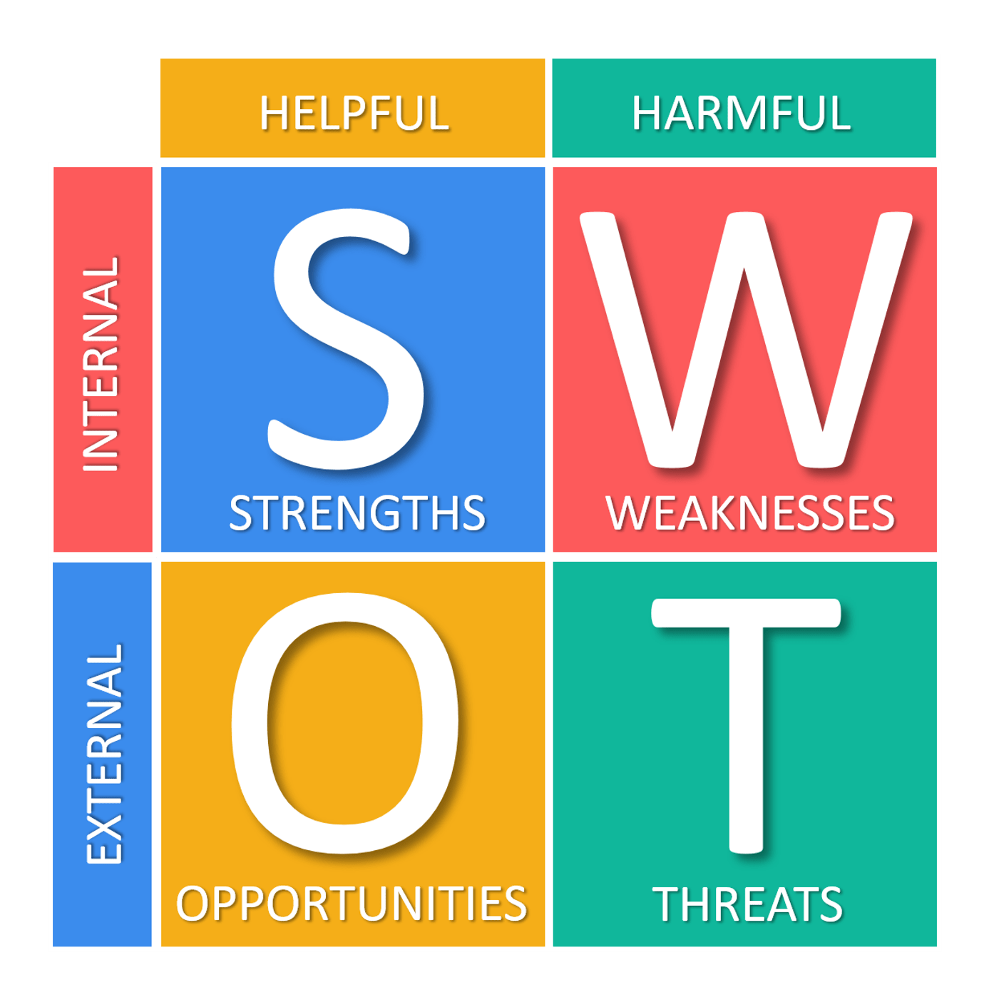
Identify the company's internal strengths and weaknesses.
Once the historical profile is completed, you can begin the SWOT analysis. Use all the incidents you have charted to develop an account of the company's strengths and weaknesses as they have emerged historically. Examine each of the value creation functions of the company, and identify the functions in which the company is currently strong and currently weak. Some companies might be weak in marketing; some might be strong in research and development. Make lists of these strengths and weaknesses. The SWOT checklist gives examples of what might go in these lists.

Slide 8
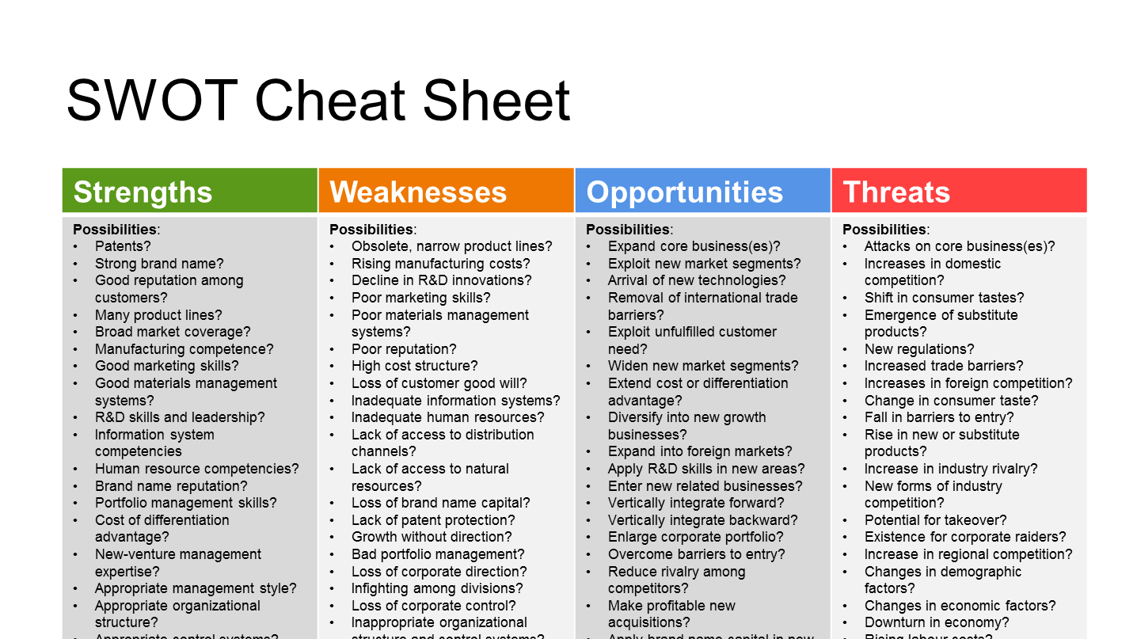

Slide 9
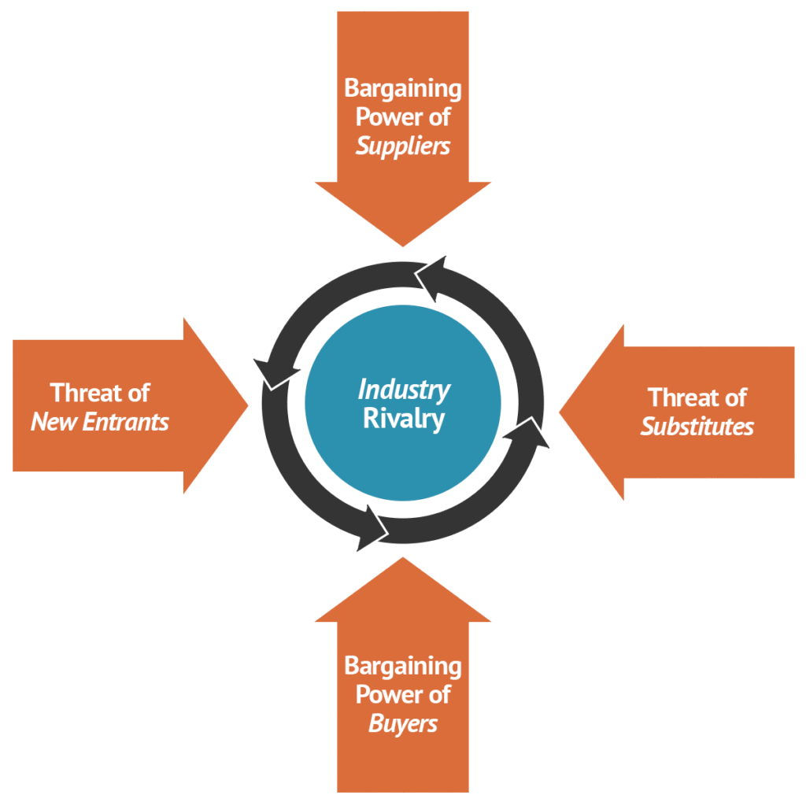
Analyse the external environment
The next step is to identify environmental opportunities and threats. Here you should apply all information you have learned on industry and macroenvironments, to analyse the environment the company is confronting. Of particular importance at the industry level is Porter's five forces model and the stage of the life cycle model. Which factors in the macroenvironment will appear salient depends on the specific company being analysed. However, use each factor in turn (for instance, demographic factors) to see whether it is relevant for the company in question.
Having done this analysis, you will have generated both an analysis of the company's environment and a list of opportunities and threats. The SWOT checklist lists some common environmental opportunities and threats that you may look for, but the list you generate will be specific to your company.

Slide 10
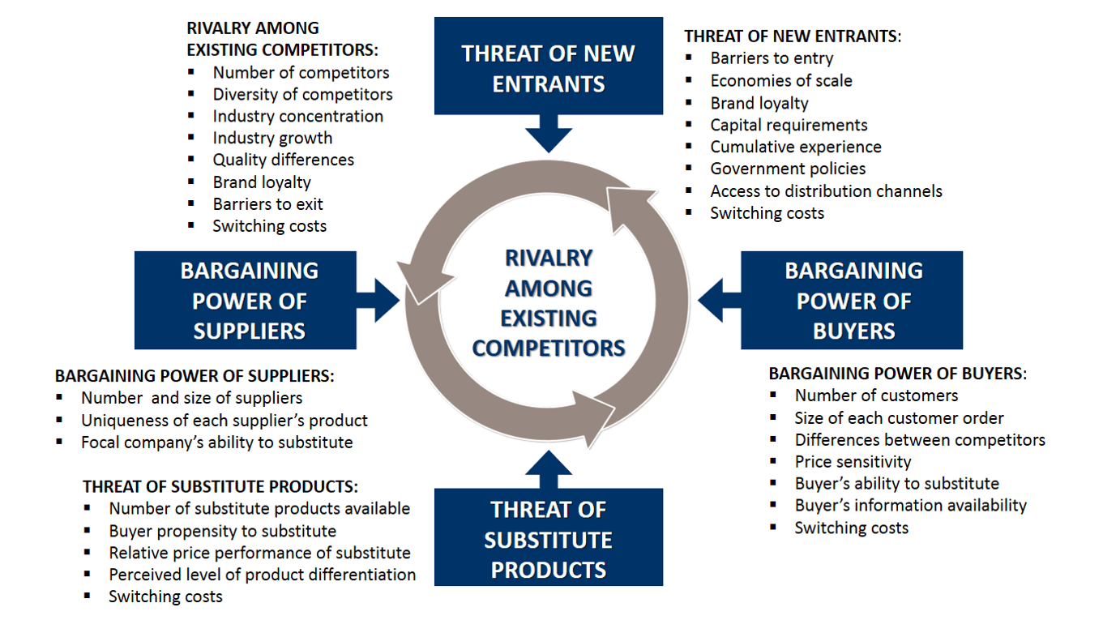

Slide 11

Evaluate the SWOT analysis
Having identified the company's external opportunities and threats as well as its internal strengths and weaknesses, you need to consider what your findings mean. That is, you need to balance strengths and weaknesses against opportunities and threats. Is the company in an overall strong competitive position? Can it continue to pursue its current business- or corporate-level strategy profitably? What can the company do to turn weaknesses into strengths and threats into opportunities? Can it develop new functional, business, or corporate strategies to accomplish this change? Never merely generate the SWOT analysis and then put it aside. Because it provides a succinct summary of the company's condition, a good SWOT analysis is the key to all the analyses that follow.

Slide 12
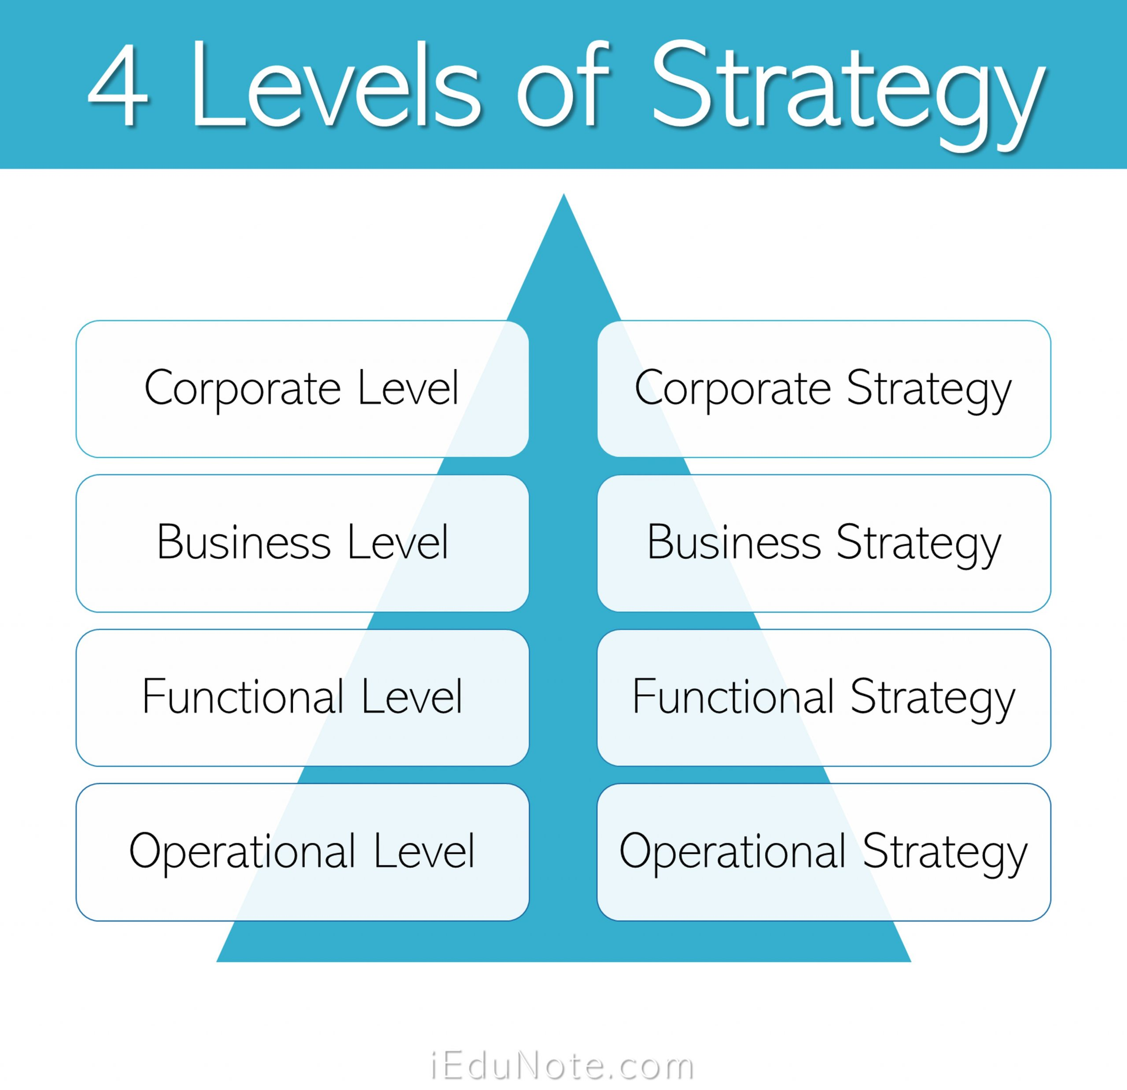
Analyse corporate-level strategy
To analyse a company's corporate-level strategy, you first need to define the company's mission and goals. Sometimes the mission and goals are stated explicitly in the case; at other times you will have to infer them from available information. The information you need to collect to find out the company's corporate strategy includes such factors as its line(s) of business and the nature of its subsidiaries and acquisitions. It is important to analyse the relationship among the company's businesses.
Do they trade or exchange resources? Are there gains to be achieved from synergy? Alternatively, is the company just running a portfolio of investments? This analysis should enable you to define the corporate strategy that the company is pursuing (for example, related or unrelated diversification, or a combination of both) and to conclude whether the company operates in just one core business. Then, using your SWOT analysis, debate the merits of this strategy. Is it appropriate, given the environment the company is in? Could a change in corporate strategy provide the company with new opportunities or transform a weakness into a strength? For example, should the company diversify from its core business into new businesses?

Slide 13

Other issues should be considered as well. How and why has the company's strategy changed over time? What is the claimed rationale for any changes? Often it is a good idea to analyse the company's businesses or products to assess its situation and identify which divisions contribute the most to or detract from its competitive advantage. It is also useful to explore how the company has built its portfolio over time. Did it acquire new businesses, or did it internally venture its own? All these factors provide clues about the company and indicate ways of improving its future performance.

Slide 14
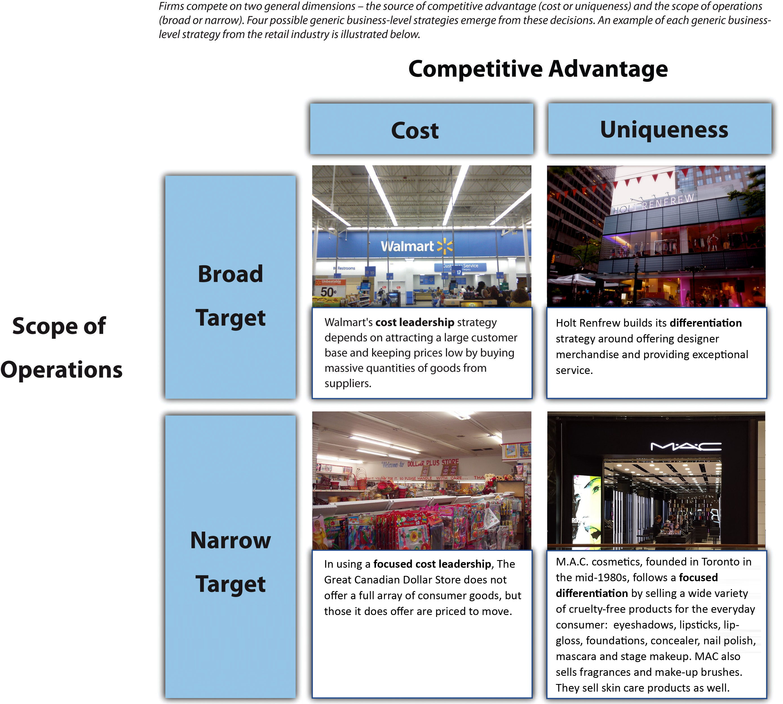
Analyse business-level strategy
Once you know the company's corporate-level strategy and have done the SWOT analysis, the next step is to identify the company's business-level strategy. If the company is a single-business company, its business-level strategy is identical to its corporate-level strategy. If the company is in many businesses, each business will have its own business-level strategy. You will need to identify the company's generic competitive strategy - differentiation, low cost, or focus - and its investment strategy, given the company's relative competitive position and the stage of the life cycle. The company also may market different products using different business-level strategies. For example, it may offer a low-cost product range and a line of differentiated products. Be sure to give a full account of a company's business-level strategy to show how it competes.

Slide 15

Identifying the functional strategies that a company pursues to build competitive advantage through superior efficiency, quality, innovation, and customer responsiveness and to achieve its business-level strategy is very important. The SWOT analysis will have provided you with information on the company's functional competencies. You should further investigate its production, marketing, or research and development strategy to gain a picture of where the company is going. For example, pursuing a low-cost or a differentiation strategy successfully requires a very different set of competencies. Has the company developed the right ones? If it has, how can it exploit them further? Can it pursue both a low-cost and a differentiation strategy simultaneously?

Slide 16

Analyse structure and control systems
The aim of this analysis is to identify that structure and control systems the company is using to implement its strategy and to evaluate whether that structure is the appropriate one for the company. Different corporate and business strategies require different structures.
For example, does the company have the right level of vertical differentiation (for instance, does it have the appropriate number of levels in the hierarchy or decentralised control?) or horizontal differentiation (does it use a functional structure when it should be using a product structure?)? Similarly, is the company using the right integration or control systems to manage its operations? Are managers being appropriately rewarded? Are the right rewards in place for encouraging cooperation among divisions? These are all issues that should be considered.

Slide 17

Make recommendations
The last part of the case analysis process involves making recommendations based on your analysis. Obviously, the quality of your recommendations is a direct result of the thoroughness with which you prepared the case analysis. The work you put into the case analysis will be obvious to the professor from the nature of your recommendations. Recommendations are directed at solving whatever strategic problem the company is facing and at increasing its future profitability. Your recommendations should be in line with your analysis; that is, they should follow logically from the previous discussion. For example, your recommendation generally will center on the specific ways of changing functional, business, and corporate strategy and organisational structure and control to improve business performance. The set of recommendations will be specific to each case, and so it is difficult to discuss these recommendations here. Such recommendations might include an increase in spending on specific research and development projects, the divesting of certain businesses, a change from a strategy of unrelated to related diversification, an increase in the level of integration among divisions by using task forces and teams, or a move to a different kind of structure to implement a new business-level strategy. Again, make sure your recommendations are mutually consistent and are written in the form of an action plan. The plan might contain a timetable that sequences the actions for changing the company's strategy and a description of how changes at the corporate level will necessitate changes at the business level and subsequently at the functional level.

Slide 18


